Slide 1
Frequency domain description
M (ω ) = H (e^{iω} )
Bode plots:
_{u = e}iωt
y = H (e^{iω} )e^{iωt}
Example:
ϕ (ω ) = arg H (e^{iω} )
Bode Diagra m
15
Magnitude (dB)
10
1
5
H (z) =
0
z − 0.7
-5
0
-45
|H| is often measured in dB
Phas e (deg)
-90
-135
-180
-2
-1
0
10
10
10
EE392m - Winter 2003
Control Engineering
Frequency (rad/sec)
2-24

Slide 2
Black-box model from data
Linear black-box model can be determined from the data, e.g., step response data
This is called model identification
Lecture 8

Slide 3
z-transform, Laplace transform
Formal description of the transfer function:
function of complex variable z
analytical outside the circle |z|≥r
for a stable system r ≤ 1
H (z) = ∑h(k )z
k =0
∞
−k
Laplace transform:
function of complex variable s
analytical in a half plane Re s ≤ a
for a stable system a ≤ 1
∞
H (s) = ∫ h(t)e^{st}dt
−∞
yˆ(s) = H (s)uˆ(s)

Slide 4
Stability analysis
Transfer function poles tell you everything about stability
Model-based analysis for a simple feedback example:
y = H (z)u H (z)K
u = −K ( y − y )
y = y = L(z) y
1 + H (z)K
d
d
d
If H(z) is a rational transfer function describing an IIR model
Then L(z) also is a rational transfer function describing an IIR model

Slide 5
Poles and Zeros <=> System
1
Impulse Re sponse
…not quite so!
Example:
0.8
Amplitude
0.6
z
0.4
y = H (z)u =
z − 0.7
0.2
0
0
5
10 15 20
Time (sec)
25
FIR model - truncated IIR
_{z}19
+ 0.7z¹⁸ + 0.49z¹⁷
+ ... + 0.001628 z + 0.00114
y = H_{FIR} (z)u =
_{z}19
Impulse Re sponse
1
0.8
0.6
0.4
0.2
Amplitude
0
0
5
10 15
Time (sec)
20
25

Slide 6
IIR/FIR example - cont’d
Feedback control:
z
y = H ( z)u =
z − 0.7
u = −K ( y − y_{d} ) = −( y − y_{d} )
Closed loop:
0.8
Impulse Re sponse
H (z)
y =
u = L(z)u
0.6
1 + H (z)
Amplitude
0.4
H ( z)
0.2
y = ^{FIR} u = L_{FIR} (z)u
1 + H_{FIR} (z)
0
0
5
10 15 20
Time (sec)
25

Slide 7
IIR/FIR example - cont’d Poles and zeros
Blue: Loop with IIR model poles x and zeros o
0.8
0.6
0.4
0.2
Red: Loop with FIR model poles x and zeros o
0
-0.2
-0.4
-0.6
-0.8
-0.8
-0.6
-0.4
-0.2
0
0.2
0.4
0.6
0.8

Slide 8
LTI models - summary
Linear system can be described by impulse response
Linear system can be described by frequency response = Fourier transform of the impulse response
FIR, IIR, State-space models can be used to obtain close approximations of a linear system
A pattern of poles and zeros can be very different for a small change in approximation error.
Approximation error <=> model uncertainty

Slide 9
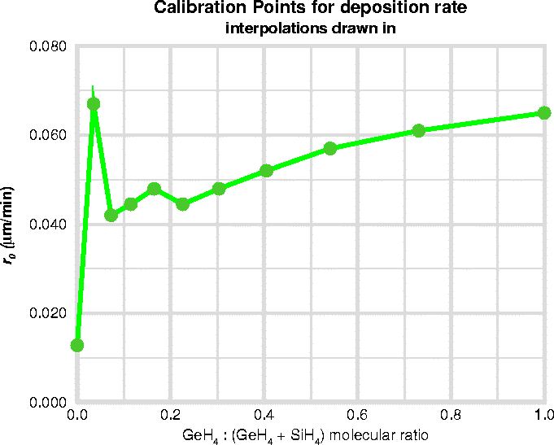
Nonlinear map linearization
Nonlinear - detailed model
Linear - conceptual design model
Static map, gain range, sector linearity
Differentiation, secant method
y = f (u) ≈ ^{Δf} (u − u )
Δu
0

Slide 10
Nonlinear state space model linearization
Linearize the r.h.s. map x = f ( x, u) ≈ ^{Δf} ( x − x ) + ^{Δf} (u − u )
_{Δx} ⁰ _{Δu} ⁰
q
v
q = Aq + Bv
Secant method
⎡Δf ⎤ ^{j}
f ( x + s _{j} )
⎢_{⎣ Δx} ⎥⎦ ⁼
s
j
s _{j} = [0 ... 1 ... 0]
# j
Or … capture a response to small step and build an impulse response model

Slide 11
Sampled time vs. continuous time
Continuous time analysis (Digital implementation of continuous time controller)
– Tustin’s method = trapezoidal rule of integration for H (s) = ¹
s
⎛ 2 1 − z⁻¹ ⎞
H (s) → H_{s} (z) = H ⎜ s =
⋅
−1 ⎟
T 1 + z
⎝ ⎠
– Matched Zero Pole: map each zero and a pole in accordance with
s = e^{sT}
Sampled time analysis (Sampling of continuous signals and system)

Slide 12
Sampled and continuous time
Sampled and continuous time together
Continuous time physical system + digital controller
– ZOH = Zero Order Hold
A/D, Sample
Control computing
D/A, ZOH
Sensors
Actuators
Physical system

Slide 13
Signal sampling, aliasing
Nyquist frequency:
ω_{N}= ½ω_{S}; ω_{S}= 2π/T
Frequency folding: kω_{S}±ω map to the same frequency ω
Sampling Theorem: sampling is OK if there are no frequency components above ω_{N}
Practical approach to anti-aliasing: low pass filter (LPF)
Sampled→continuous: impostoring
Low Pass Filter
A/D, Sample
Digital D/A, ZOH computing
Low Pass Filter

Slide 14
Simulation
Euler integration method: x(t + d ) = x(t) + d ⋅ f (x(t), t )
Runge-Kutta: ode45 in Matlab
Can do simple problems by integrating ODEs
Issues:
mixture of continuous and sampled time
hybrid logic (conditions)
state machines
stiff systems, algebraic loops
systems integrated out of many subsystems
large projects, many people contribute different subsystems
ODE solution
– dynamical model: x = f ( x, t)

Slide 15
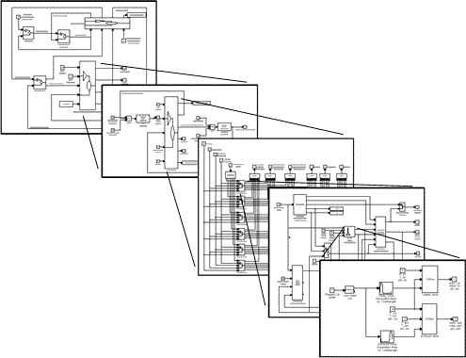
Simulation environment
Simulink by Mathworks
Matlab functions and analysis
Stateflow state machines
Ptolemeus - UC Berkeley
Block libraries
Subsystem blocks developed independently
Engineered for developing large simulation models
Supports code generation
EE392m - Winter 2003 Control Engineering 2-38

Slide 16
Model block development
Look up around for available conceptual models
Physics - conceptual modeling
Science (analysis, simple conceptual abstraction) vs. engineering (design, detailed models - out of simple blocks)
2-16

Slide 17
Modeling uncertainty
Modeling uncertainty:
unknown signals
model errors
Controllers work with real systems:
Signal processing: data → algorithm → data
Control: algorithms in a feedback loop with a real system
BIG question: Why controller designed for a model would
ever work with a real system?
Robustness, gain and phase margins,
Control design model, vs. control analysis model
Monte-Carlo analysis - a fancy name for a desperate approach
2-17

